Slide 1
Introduction to Bulk Load Utilities (including VSM)
April, 2013

Slide 2
Agenda
Standard Loader
Fast Loader
Loading into VSM/SSM

Slide 3
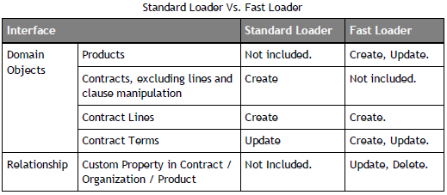
ECM Bulk Load Utilities (BLU): Overview
A common task, especially for new implementations is to load a potentially large number of contracts and other data from an outside source, such as another contract management (legacy) system or scanned paper contracts
ECM provides two bulk load utilities, with relatively little overlap in functionality (see chart below):
    Standard Loader
    Fast Loader
The reference for these utilities is the Bulk Load Utilities Guide.

Slide 4
Standard Loader: Overview
Standard Loader transfers contract data and Lines from input files to ECM Repository.
    Load request is uploaded in the form of an HTTP multi-part request.
    On ECM application server, HTTP request is transformed into an import job.
    Scheduling and execution of the import job is handled by a job scheduler.
    Upon job execution, the contract data file is parsed and each row in the file is processed.
Contract data needs to be captured in specified file format prior to the load
    Supports Excel and CSV files for data input.
    Sequence of data in each input file must exactly follow specifications (see topic “Prepare Input Files” in the Guide)
Supports loading of Authored, Filed, and Amendment contracts
Runs on Windows and Linux

Slide 5
Standard Loader: Notes
Three sample input files are provided with ECM. They are for Contracts, Parties, and Lines. Each Contracts row supplies the property values for the contract, and points to the contract file. The Parties and Lines files can only be uploaded along with a Contracts file, and they point to the related contract and supply the data for it.
A contract template can be named in Contracts file for each contract loaded
    Contract template can also specify folders, events, and security. These are considered by the loader; e.g., contract will be loaded into specified folder.
Custom Property fields cannot be loaded (known deficiency), but they can be updated with the Fast Loader
User-defined Term Definitions and their values can be specified for the load
Up to ten attachments of up to 10MB each can be specified, with a 2GB maximum volume for the entire Import.
    A common issue is having PDF attachments that are too large, so break them up if necessary.

Slide 6
Standard Loader: Notes, cont.
Before running the loader, all related prerequisite objects must be created or populated: contract templates, contract classes, term definitions, value lists, and permissions. Also, Java must be enabled and the proper JDK installed.
Invocation of the loader can be done via Administration > Application > Jobs List > New > (Job Type = Contract)
    Browse to the Contracts (“Upload”) input file, and optionally the Lines and/or Parties files, and any Attachments.
    Schedule the time to run the job and click OK to submit
Command line invocation is also possible and provides additional flexibility
Output of the loader are a Success log file, an Error log file, and a copy of the Contracts input file, but containing only the rows that weren't loaded.
    Errors aren't reported terribly well; e.g., errors related to size limits being exceeded, and if there's an error in column C of the spreadsheet, it doesn't check columns D and higher.

Slide 7
Standard Loader: Notes, cont.
Successfully loaded contracts can have a Status of Draft, Executed, Active, Expired, depending on the effective start and end dates (as usual).
Implementation Project considerations:
Only “relevant and necessary” contracts should be loaded, such as Active contracts and those that expired in the last few years. However, one customer loaded 1M contracts (and 600K suppliers).
Services should not take responsibility for the data being loaded, but should assist with the usage of the loader.
Start with a very few contracts to test spreadsheets and the process, but even later it is recommended to have batches smaller than a few thousand rows.
    For example, you may find that task reassignments associated with a load result in a large number of notifications. If this occurs, the recommendation is to disable the appropriate notification(s), run the load, and then re-enable the notification(s). This may only be practical in off hours.

Slide 8
Fast Loader: Overview
Fast Loader is SQL-based bulk load utility that enables load of high volumes of data into ECM on a recurring and non-recurring basis.
Loading is much faster than with Standard Loader, but doesn't handle contracts.
Fast Loader uses staging tables to load data to the application objects, and database stored procedures to drive the SQL load. The stored procedures contain the business validation and process control logic to ensure the integrity of the data loaded into the ECM Repository.
The Fast Loader allows you to create and update Contract Lines and Contract Terms. In addition, you can update or delete custom properties in contracts, organizations, and products.
The Fast Loader is invoked by calling the appropriate stored procedures. This can be done through an integration server or another invocation method and custom script. Also, if loading Contract Lines, you can use the Contract Lines tab in the user interface, but the data input file type is limited to CSV.

Slide 9
Loading into VSM/SSM
Through the Batch Uploads module of VSM, you can upload (import) business objects needed for ECM, such as organizations, contacts, and users. (Upload of groups is not supported.)
    Virtual Supply Master > Administration tab > Batch Uploads / Batch Upload Definitions
    You can also schedule a batch job for downloading (exporting) objects.
First step is to create a batch upload definition (identified by a “Format Name”) for the appropriate object. This essentially defines the spreadsheet that you use to provide the upload data. No upload definitions are provided with ECM.
You can then download the template spreadsheet for the upload definition and edit it to supply the data.
Finally, you create a Batch Upload (job), pointing to the upload definition and the data file(s) to be uploaded from.
The reference for this feature is the SSM Administrator Guide.

Slide 10
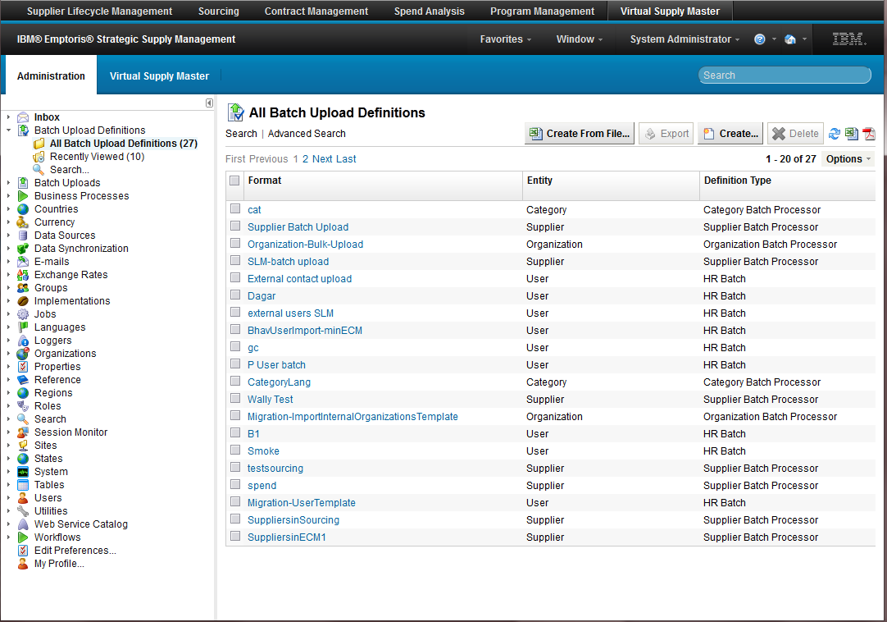
Batch Import – How to…
Batch Importing
If you want to import anything into the system, you must create a definition
Navigate –
  Administration
  Batch Upload Definitions
  All Batch Upload Definitions
Create…
FYI – There are no OOTB definitions
FYI - Create From File… doesn’t currently work with non-generic processors – Do not use

Slide 11
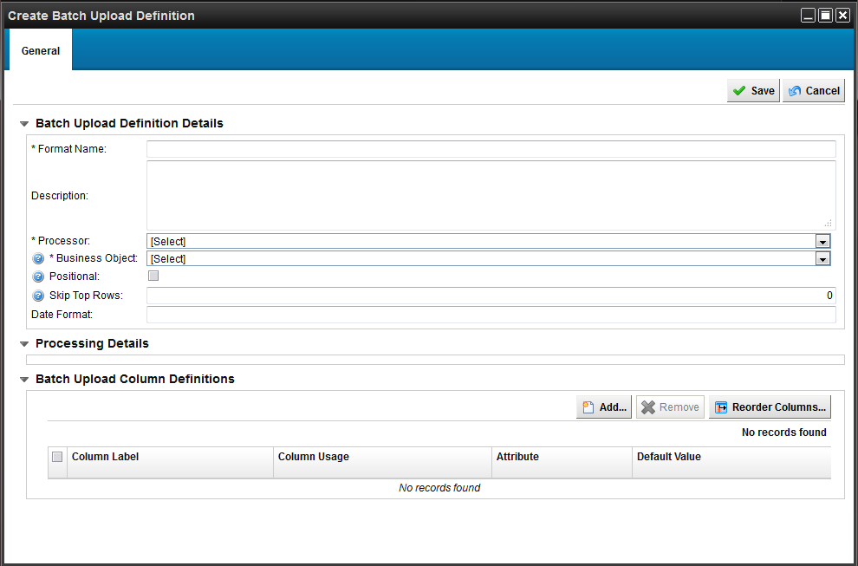
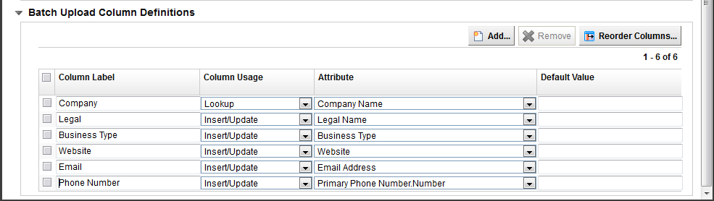
Batch Import – How to…
Create Definition
To have the system create a template for you…
Click Create
Enter Required Name
Select the appropriate processor for your purpose
  Category
  Country
  Region
  State / Province Subdivision
  Organization
  Industry Code
  HR
  Supplier
Select the applicable Data Source
To create a custom template…
Edit column labels, usage and attributes, reorder and remove
  Lookup - Use to search uniqueness if it exists and update, otherwise insert
  Insert / Update
  Ignore
Save
FYI –
Be cognizant of your required fields for an object as the definition creation will not warn you, otherwise the system will throw errors when performing the import with the definition
org.hibernate.exception.ConstraintViolationException: Could not execute JDBC batch update

Slide 12
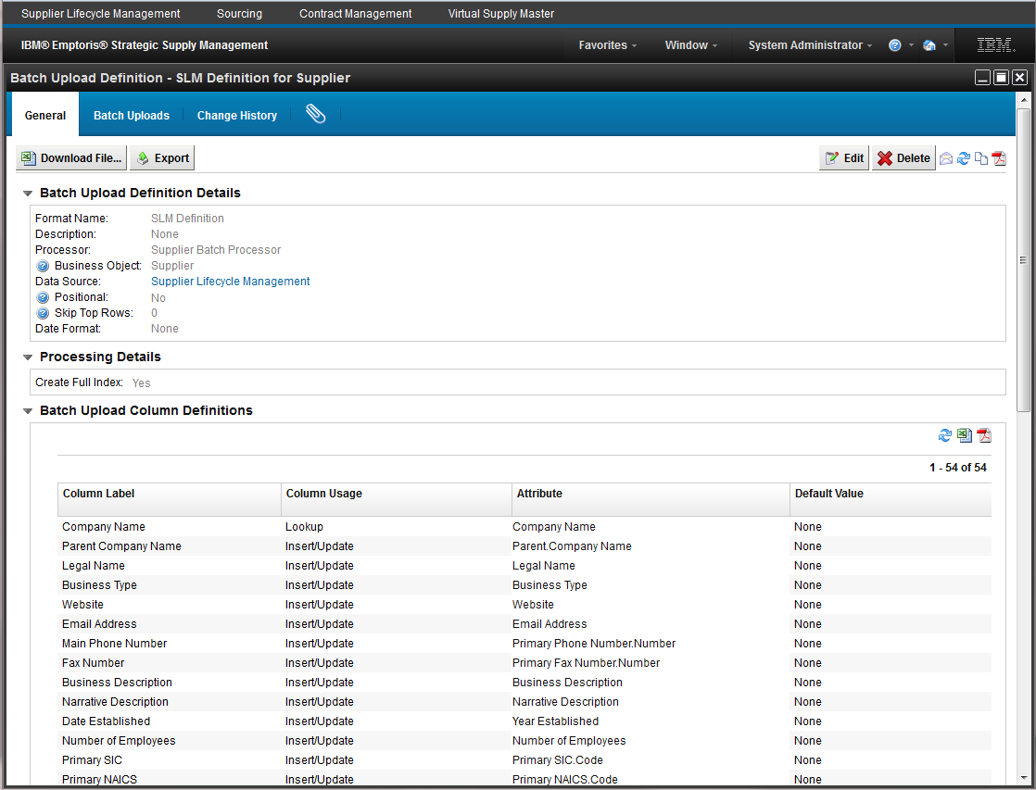
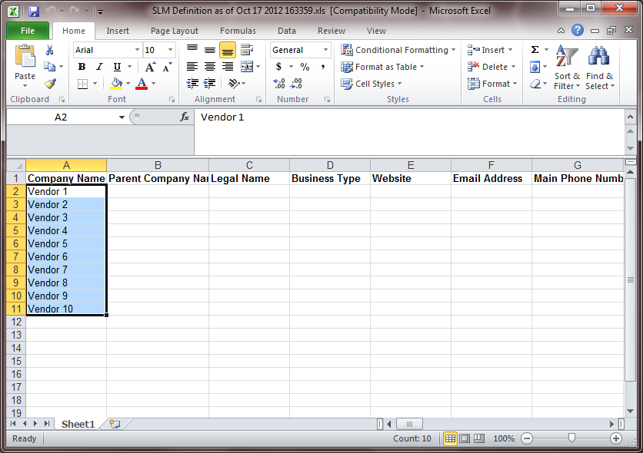
Batch Import – How to…
Download
Click
  Download File…
Save to local machine
Update your file and save
FYI – We currently do not support XLSX (2010) format
  Only XLS and CSV

Slide 13
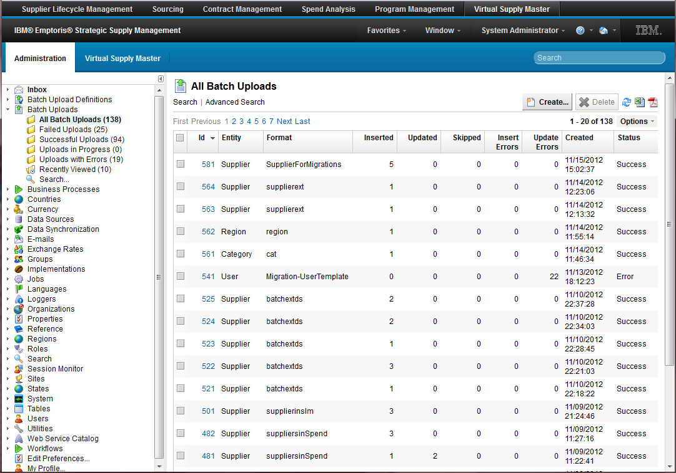
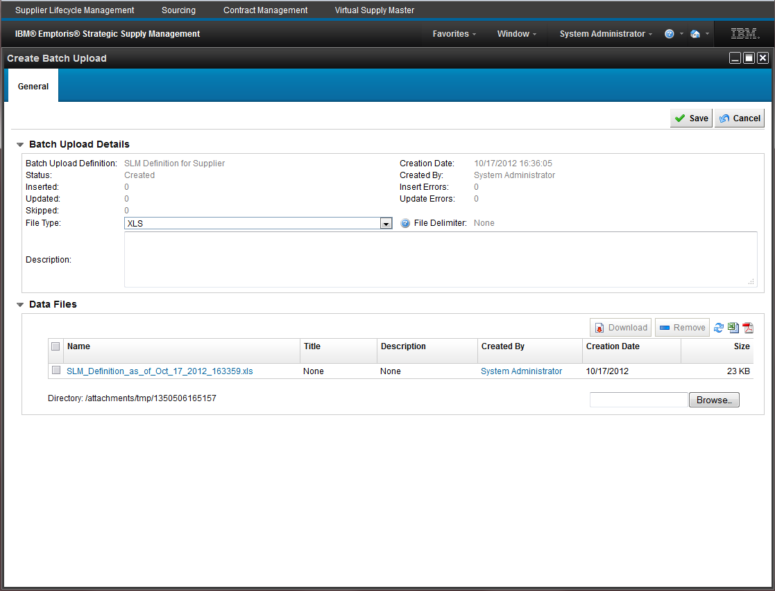
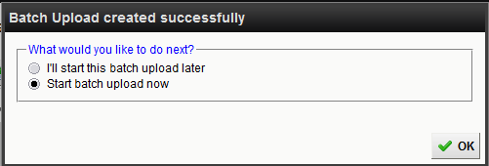
Batch Import – How to…
Import
Navigate –
  Administration
  Batch Uploads
  All Batch Uploads
Create…
Select the appropriate batch upload definition
Browse…
  Your local machine
Save
Schedule to run now or later
  Later places the upload in “Created” status

Slide 14
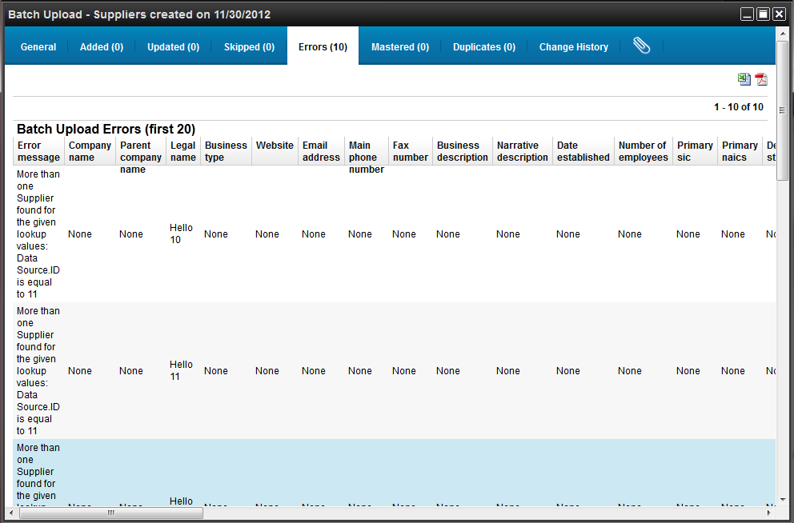
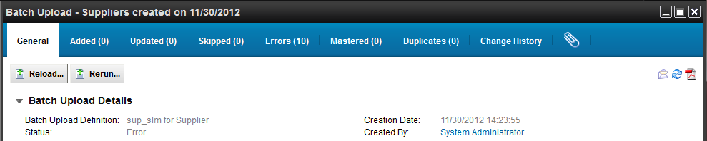
Batch Import – How to…
Export – Error File and Reload
Navigate to the completed process
Go to Errors tab
Click the spreadsheet icon
Save to local
Delete Error Message column
Fix rows and save
General tab – Reload…
Browse…
  Your local machine
Save
Schedule to run now or later
Notes:
You can set up– do a lookup field;
Updates/insert

Slide 15
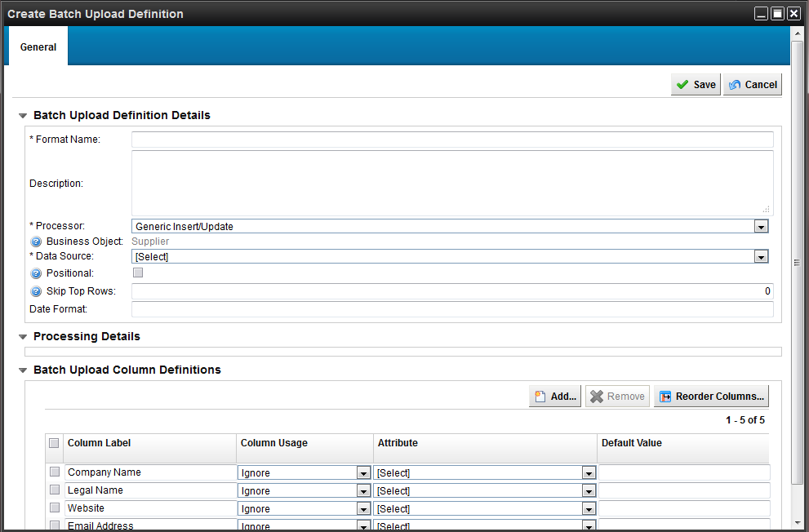
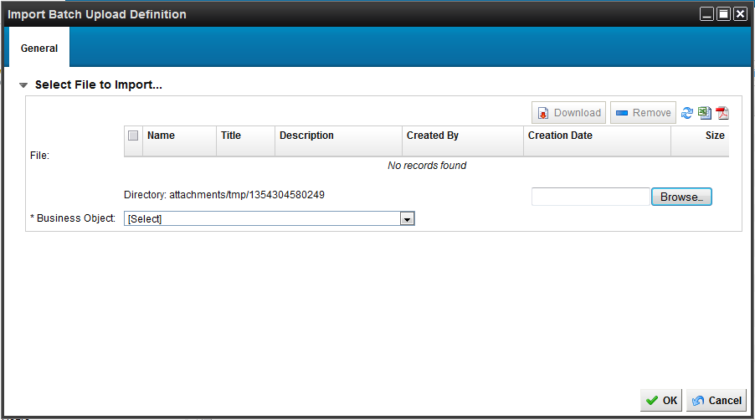
Batch Import – How to…
Create Definition From File
To have the system create a template for you based off your own file…
Click Create From File…
Browse…
  Your local machine
Select the appropriate Business Object
Click OK
Enter Required Name
Select the appropriate processor for your purpose
Select the applicable Data Source
Edit column usage and select mapped attribute
  Lookup
  Insert / Update
  Ignore
Save

Slide 16

Questions?

